Slide 1

6th Grade Math
Unit 2, Lesson 3 Rewriting Expressions Using the Distributive Property Volume 1, pg. 58

Slide 2


Benchmark
MA.6.NSO.3.2
Rewrite the sum of two composite whole numbers having a common factor, as a common factor multiplied by the sum of two whole numbers.
volume 1, pg. 58

Slide 3
Integrated Mathematical Thinking and Reasoning Standards
MA.K12.MTR.1.1 Actively participate in effortful learning both individually and collectively.
MA.K12.MTR.2.1 Demonstrate understanding by representing problems in multiple ways.
volume 1, pg. 58

Slide 4

Learning Target
I can use the distributive property to generate equivalent numeric expressions.
volume 1, pg. 58

Slide 5

Warm-Up
volume 1, pg. 58

Slide 6
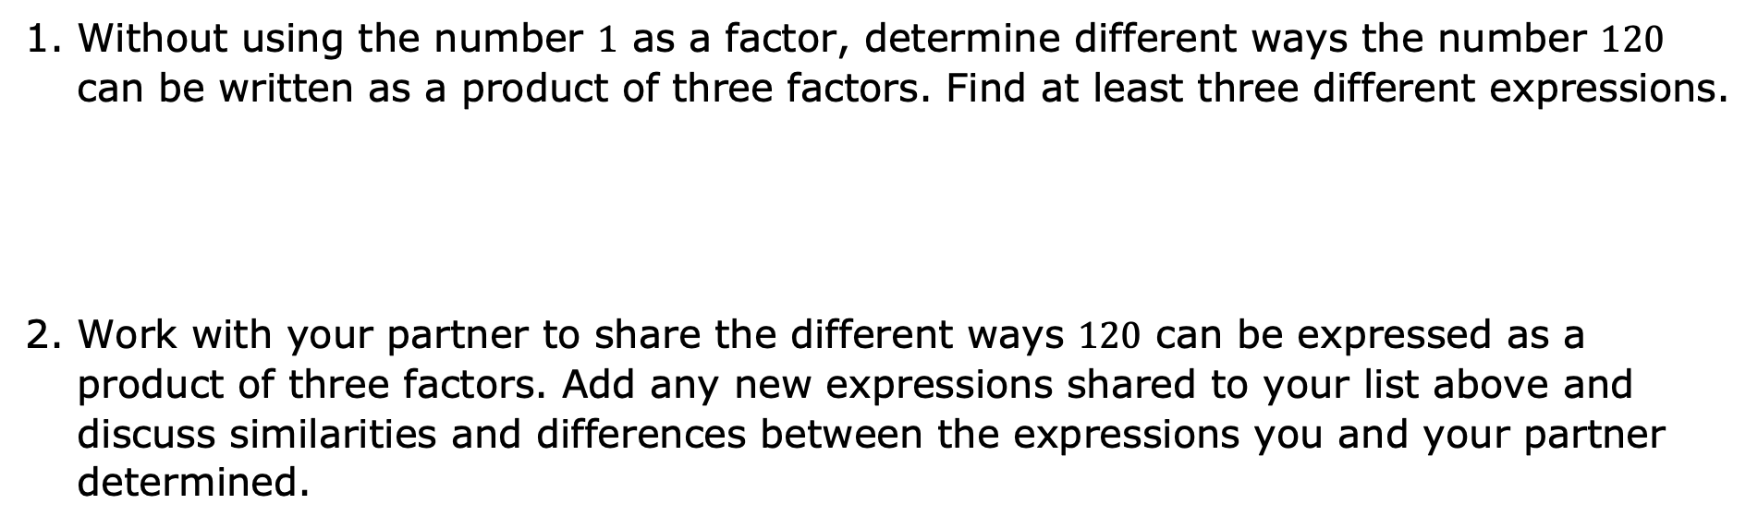
2.3.1 Warm-Up: How Many Ways?
Without using the number $1$ as a factor, determine different ways the number $120$ can be written as a product of three factors. Find at least three different expressions.
Work with your partner to share the different ways $120$ can be expressed as a product of three factors. Add any new expressions shared to your list above and discuss similarities and differences between the expressions you and your partner determined.
volume 1, pg. 58

Slide 7

Exploration
volume 1, pg. 59

Slide 8

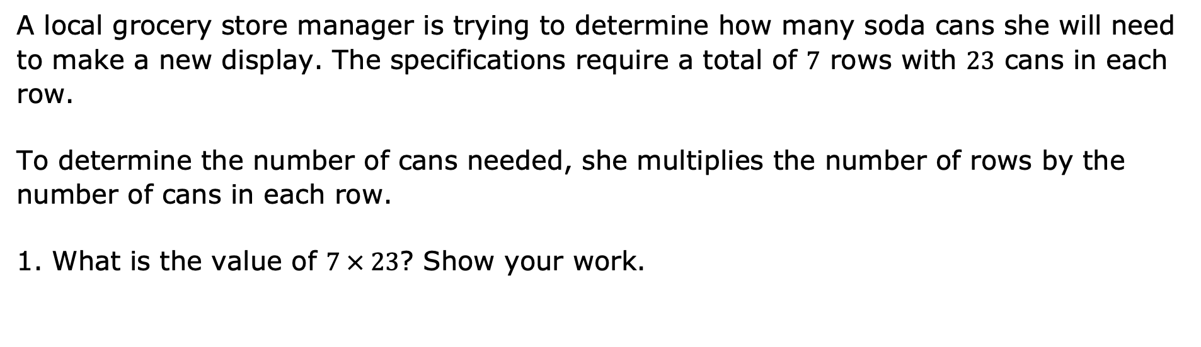
2.3.2 Exploration:
The Distributive Property
A local grocery store manager is trying to determine how many soda cans she will need to make a new display. The specifications require a total of $7$ rows with $23$ cans in each row.
To determine the number of cans needed, she multiplies the number of rows by the number of cans in each row.
What is the value of $7 × 23$? Show your work.
volume 1, pg. 59

Slide 9
Compare your work with two other students.
Name | Did you get the same answer? | Did you use a similar method? If not, summarize their method below.
volume 1, pg. 59

Slide 10
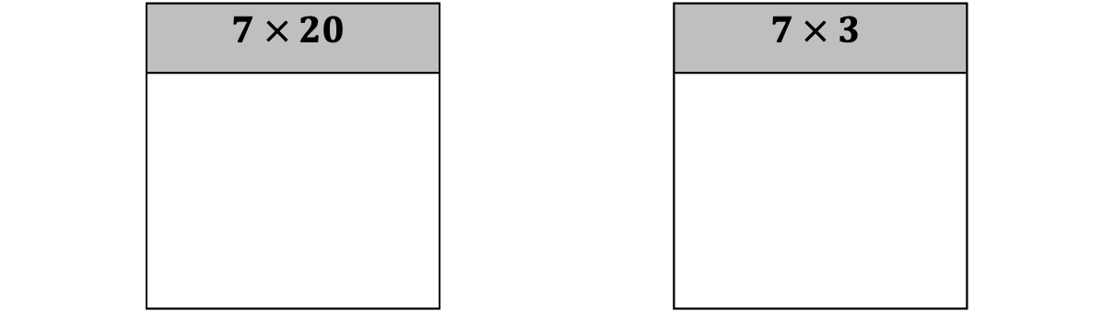
Find the products.
What is the sum of the two products?
 | $$7 × 20$$ |  | $$7 × 3$$
volume 1, pg. 59

Slide 11
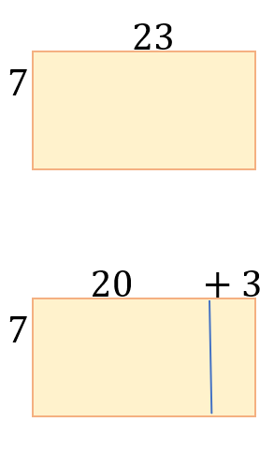
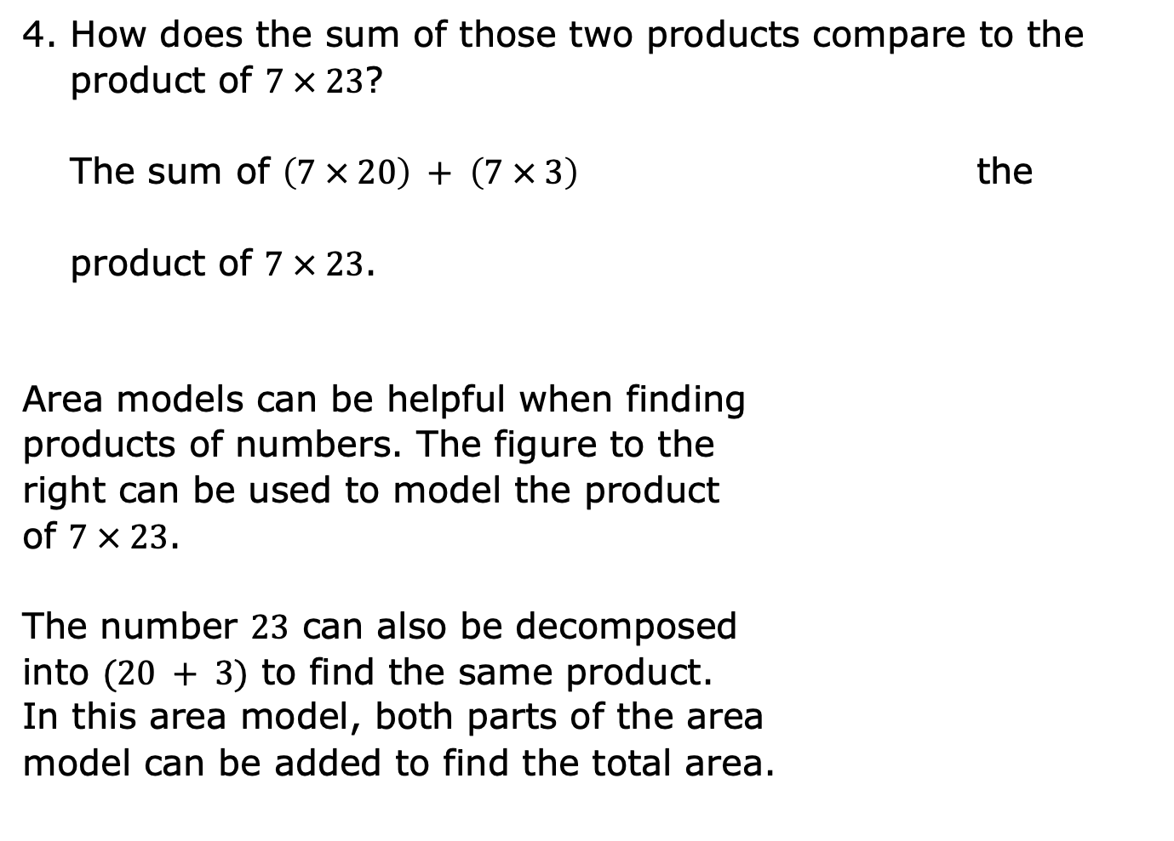
How does the sum of those two products compare to the product of $7 × 23$?
The sum of $\left(7 × 20\right) + \left(7 × 3\right)$ the
product of $7 × 23$.
Area models can be helpful when finding
products of numbers. The figure to the
right can be used to model the product
of $7 × 23$.
The number $23$ can also be decomposed
into $(20 + 3)$ to find the same product.
In this area model, both parts of the area
model can be added to find the total area.
is less than
is equal to
is greater than
volume 1, pg. 59

Slide 12
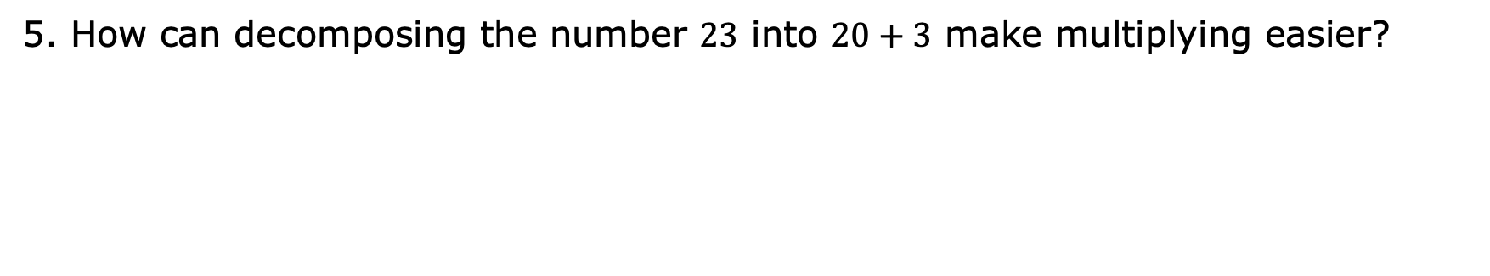
How can decomposing the number $23$ into $20+3$ make multiplying easier?
volume 1, pg. 59

Slide 13

Guided Instruction
volume 1, pg. 60

Slide 14

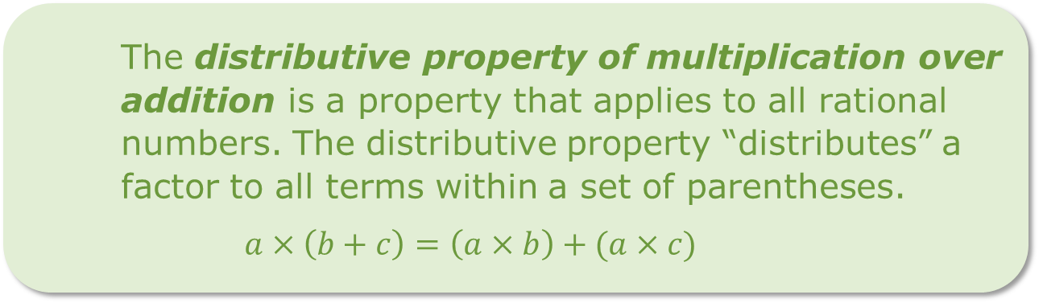

2.3.3 Guided Instruction: The Distributive Property
The product $7 × 23$can be rewritten using the distributive property by decomposing $23$ into two parts and multiplying $7$ by both parts.
$7 × 23 = 7(20 + 3)$
$$7(20 + 3) = (7 ∙ 20) + (7 ∙ 3)$$
The distributive property of multiplication over addition is a property that applies to all rational numbers. The distributive property “distributes” a factor to all terms within a set of parentheses.
$$a×\left(b+c\right)=\left(a×b\right)+(a×c)$$
volume 1, pg. 60

Slide 15
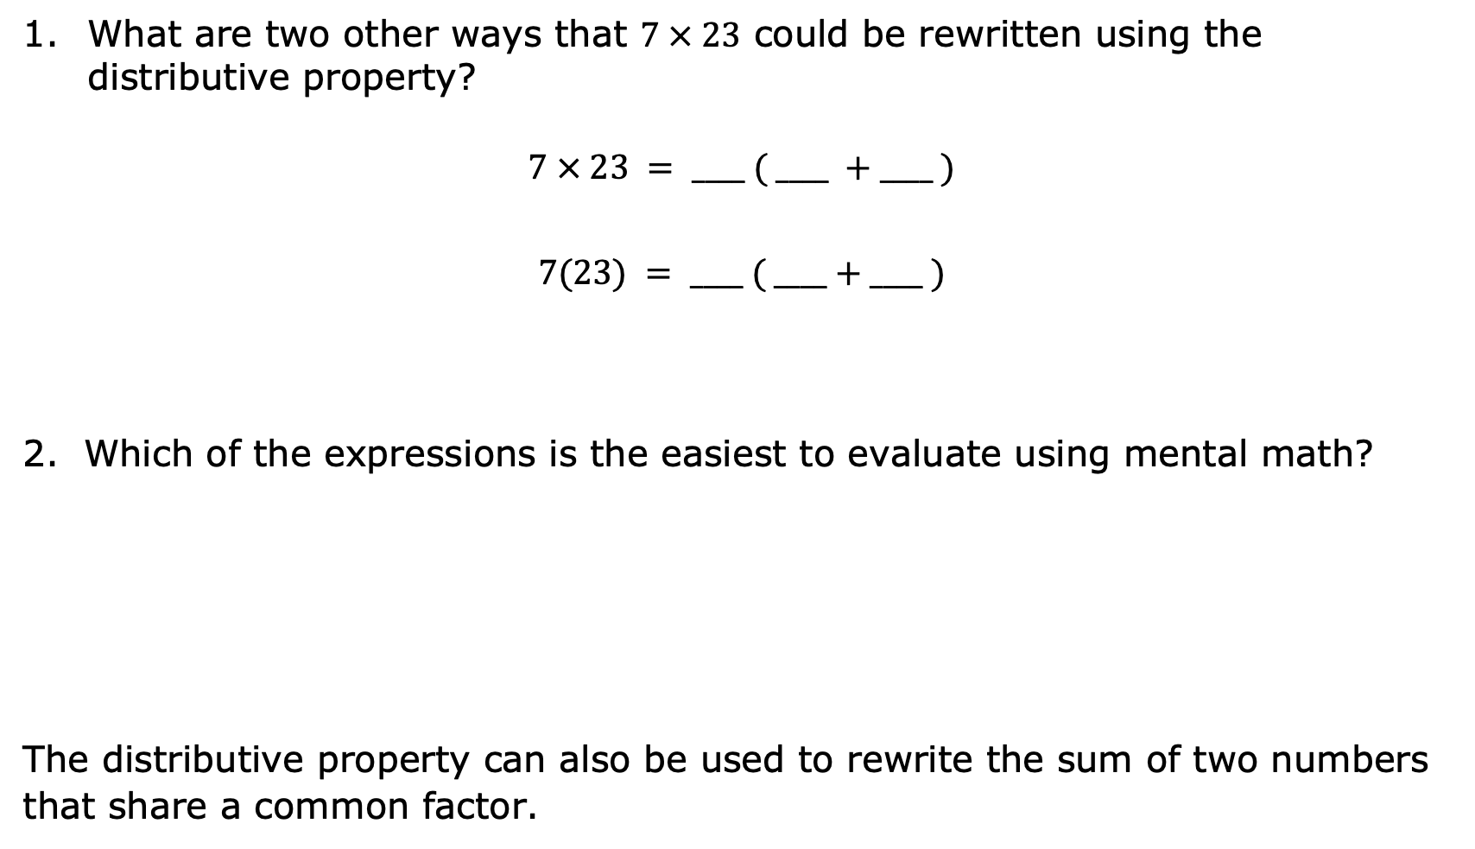
What are two other ways that $7 × 23$ could be rewritten using the distributive property?
$$7 × 23 = ____ ( ____ +____ )$$
$$7(23) = ____ ( ____+____ )$$
Which of the expressions is the easiest to evaluate using mental math?
The distributive property can also be used to rewrite the sum of two numbers that share a common factor.
volume 1, pg. 60

Slide 16
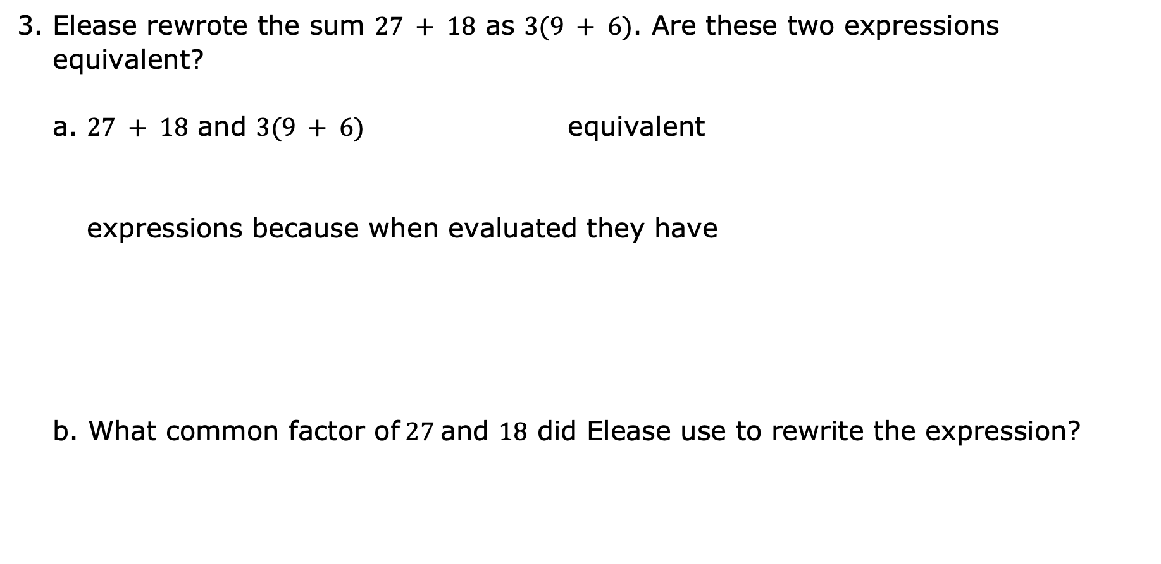
Elease rewrote the sum $27 + 18$ as $3(9 + 6)$. Are these two expressions equivalent?
a. $27 + 18$ and $3(9 + 6)$ equivalent
expressions because when evaluated they have
What common factor of$27$and $18$ did Elease use to rewrite the expression?
are
are not
the same value.
different values.
volume 1, pg. 60

Slide 17
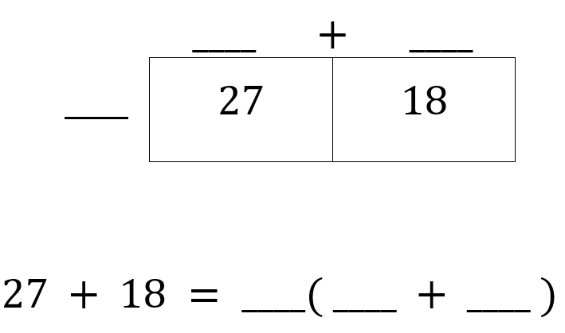
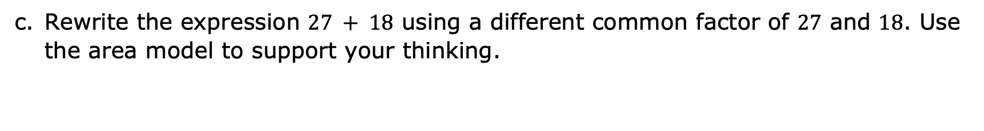
Rewrite the expression $27 + 18$ using a different common factor of $27$ and $18$. Use the area model to support your thinking.
volume 1, pg. 60

Slide 18

Guided Practice
volume 1, pg. 61

Slide 19

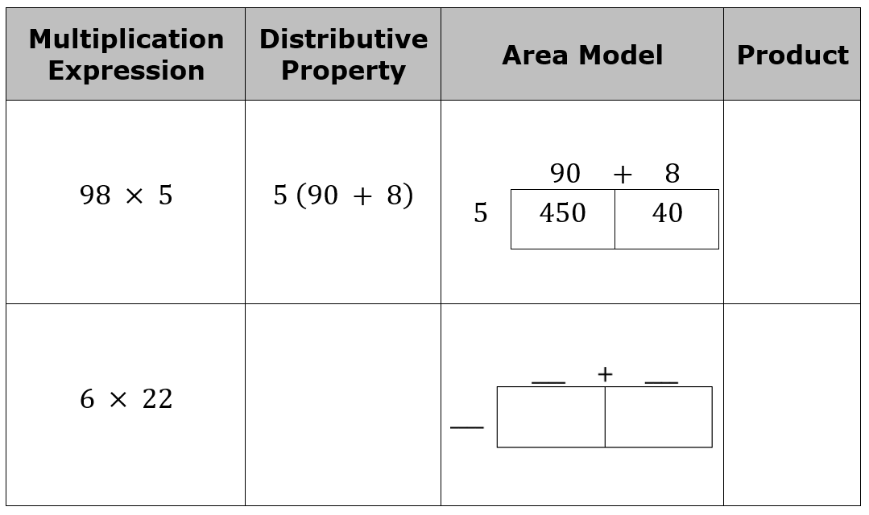
2.3.4 Guided Practice: Rewriting Expressions
Complete the table by rewriting each multiplication expression using the distributive property, modeling with area, and finding the product.
volume 1, pg. 61

Slide 20
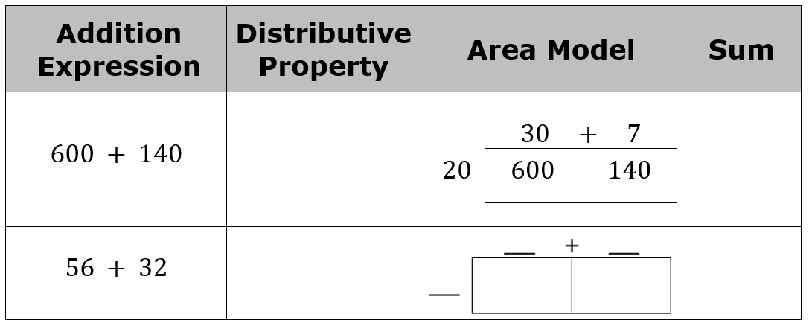
Complete the table by rewriting each addition expression using the distributive property, modeling with area, and finding the sum.
volume 1, pg. 61

Slide 21

Your Turn
volume 1, pg. 61

Slide 22
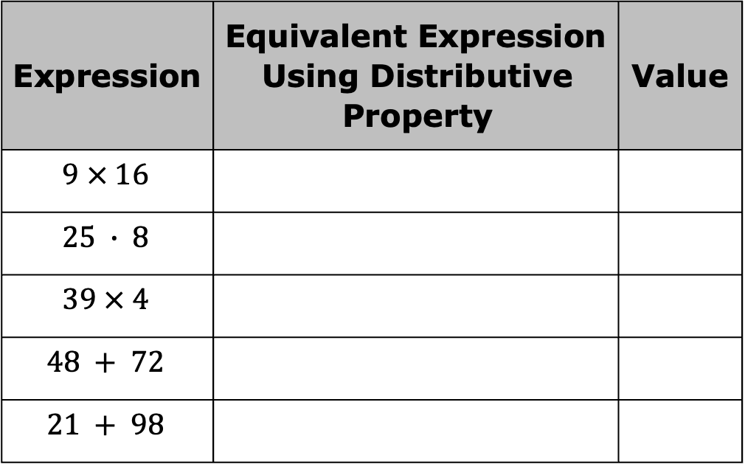
2.3.5 Your Turn!
For each expression, generate an equivalent numeric expression using the distributive property and then find the value.
Expression | Equivalent Expression Using Distributive Property | Value
$$9 × 16$$
$$25 ∙ 8$$
$$39 × 4$$
$$48 + 72$$
$$21 + 98$$
volume 1, pg. 61

Slide 23
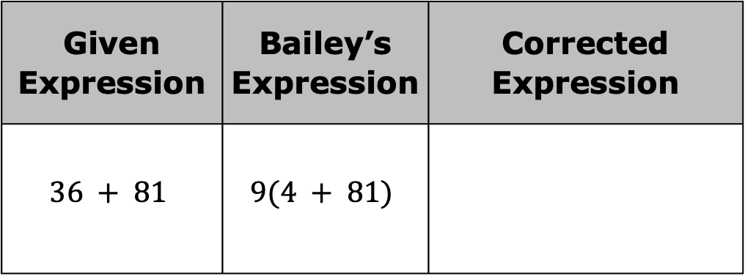
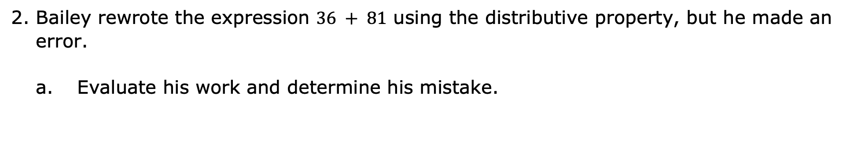
Bailey rewrote the expression $36 + 81$ using the distributive property, but he made an error.
Evaluate his work and determine his mistake.
Given Expression | Bailey’s Expression | Corrected Expression
$$36 + 81$$ | $$9(4 + 81)$$
volume 1, pg. 61

Slide 24
Help Bailey understand and learn from his mistakes. Write a brief note to Bailey explaining what his mistake was and how he can learn from it.
Means
I
Start
To
Acquire
Knowledge
Experience
Skills
volume 1, pg. 62

Slide 25

Wrap-Up
volume 1, pg. 62

Slide 26
2.3.6 Wrap-Up: Growth Mindset
Complete each statement below based on your learning today.
Today I am still unsure about _______________________
_______________________________________________.
To fill this gap, I plan to ____________________________
_______________________________________________.
volume 1, pg. 62

